Slide 1
3조 antenna Rules | ANT.3 – 15um
박재호 김규민 전제현 곽대현 이준민 윤경환 전민석

Slide 2
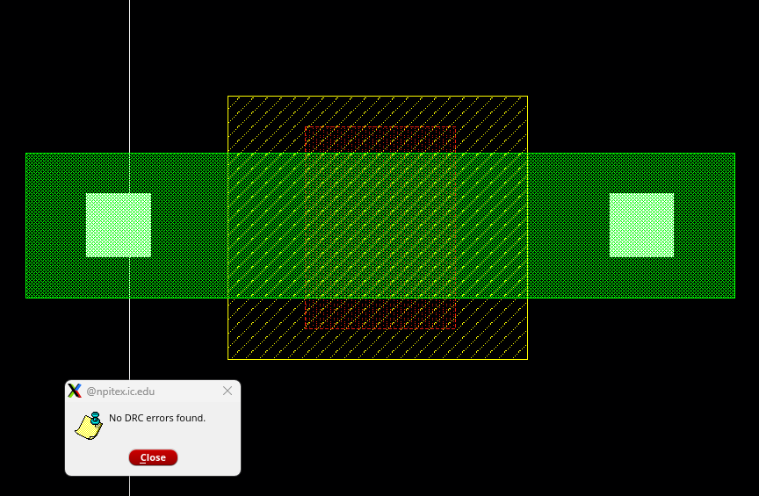
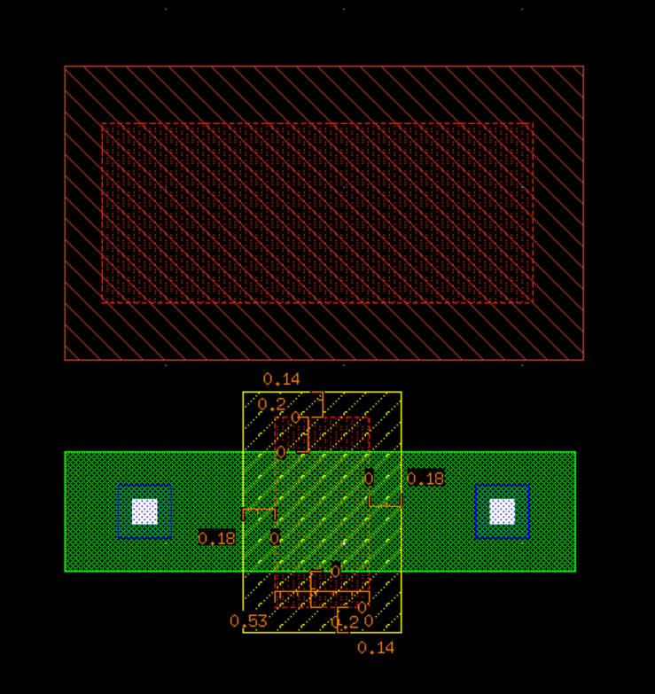
ANT.3
Maximum ratio of Poly Contact area to the gate area the Contact is connected with (>15um)
STI
P-substrate
STI

Slide 3
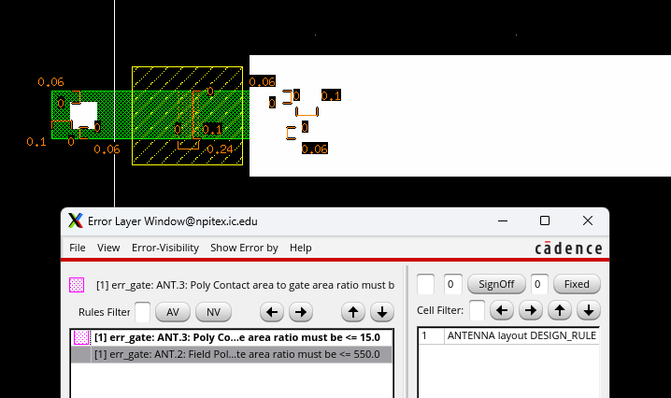
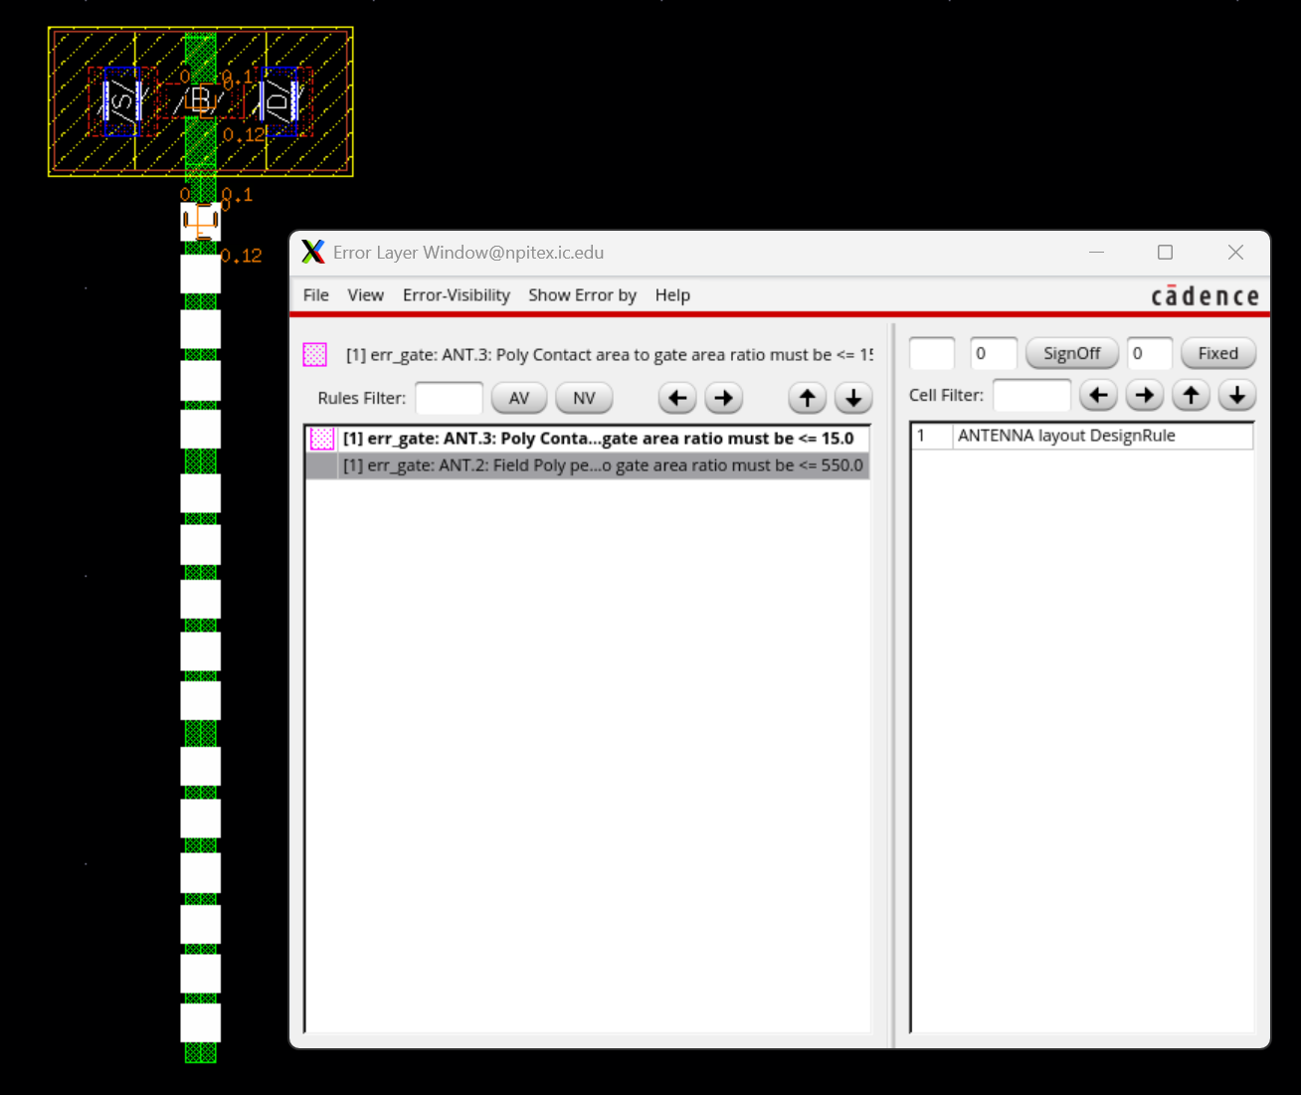
DRC
DRC error (ratio >= 15)

Slide 4
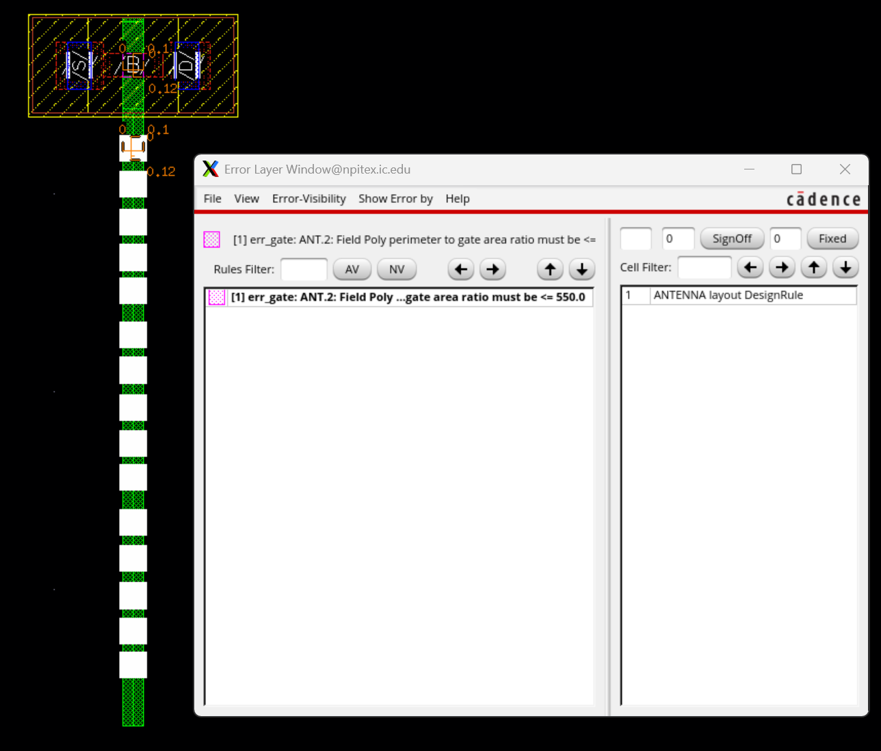
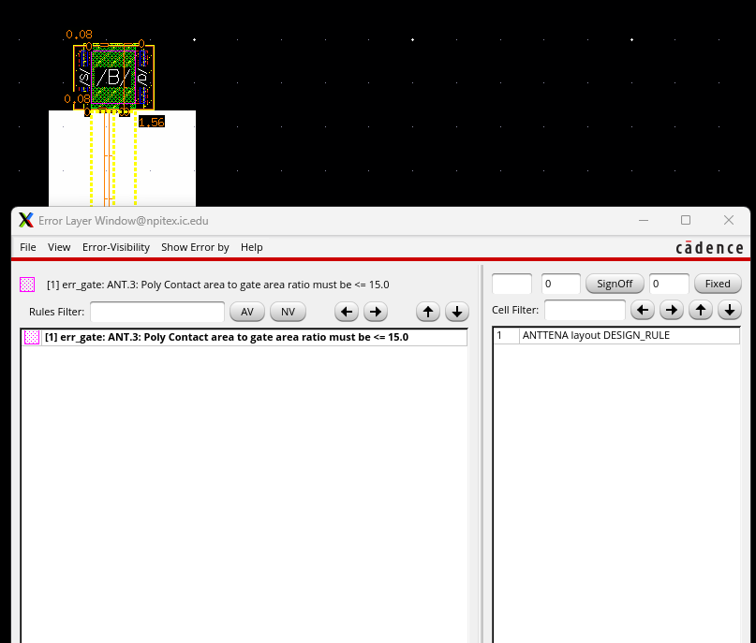
DRC

Slide 5
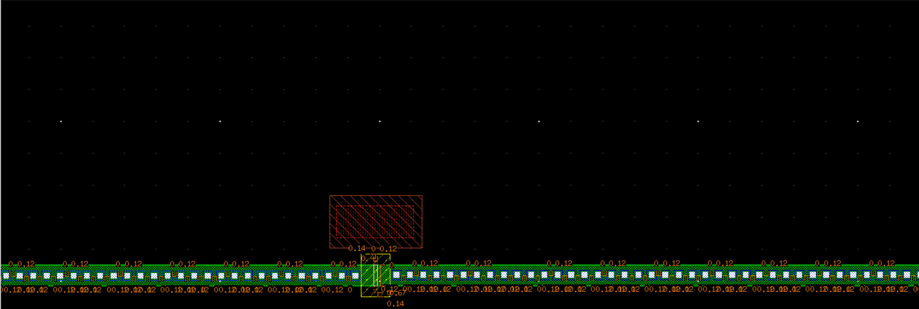
DRC

